Slide 1



Azure Management Superpowers with Pulumi
Mikhail Shilkov @MikhailShilkov

Slide 2

Agenda
Modern Infrastructure as C# and F#
100% Coverage of Azure and Kubernetes APIs
Pulumi with .NET 5 and C# 9

Slide 3
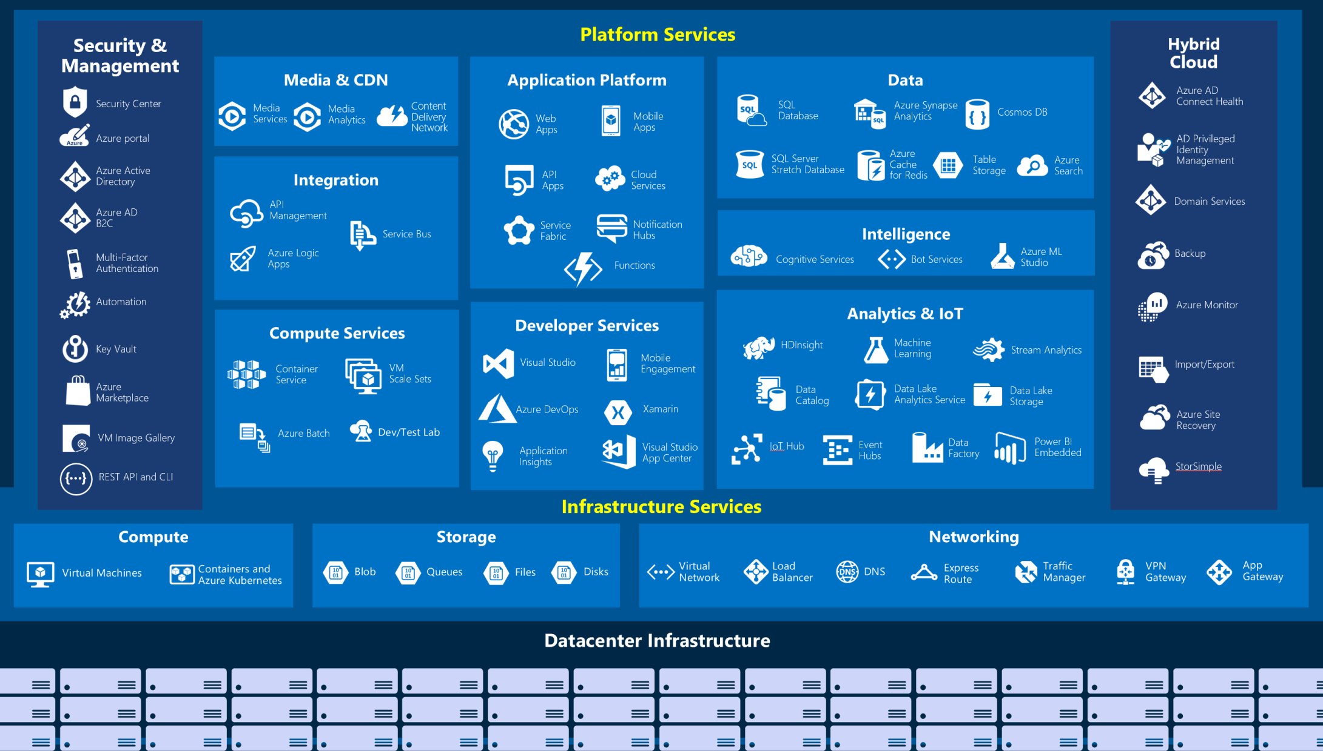
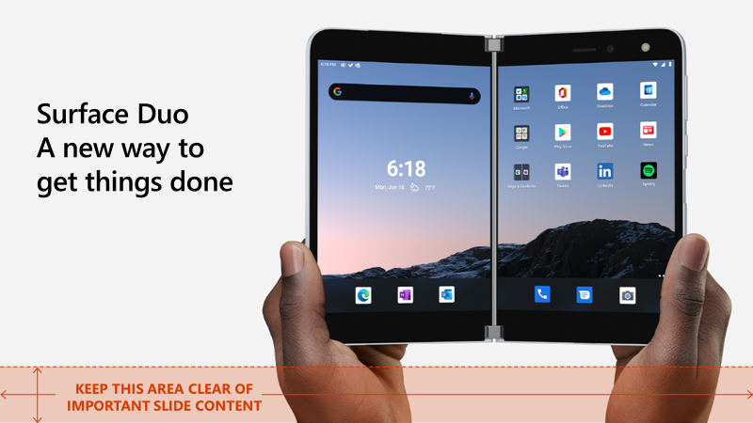

Slide 4
Why Infrastructure as Code?
Provision Cloud Resources
Automate creating and scaling environments
Use native Azure resources alongside Kubernetes
Modernize Your Approach to Cloud Engineering
Leverage “code” techniques for creation and versioning
Benefit from sharing and reuse of architectures and best practices
Apply testing and policy to your infrastructure

Slide 5
Azure NextGen Preview - 100% Azure Coverage
Fully native approach to ARM using C# and F#
Supports .NET 5, C# 9, F# 5
Same-day support for new features
A tool to convert from ARM Templates

Slide 6
Azure Resources as C#
var resourceGroup = new ResourceGroup("my-rg"); var plan = new AppServicePlan("linux-apps", new AppServicePlanArgs { ResourceGroupName = resourceGroup.Name, Kind = "Linux", Sku = new SkuDescriptionArgs { Name = "B1", Tier = "Basic" } }); var helloApp = new WebApp("hello-app", new WebAppArgs { ResourceGroupName = resourceGroup.Name, ServerFarmId = plan.Id, SiteConfig = new SiteConfigArgs { LinuxFxVersion = "DOCKER|microsoft/azure-appservices-go-quickstart”
}, HttpsOnly = true });

Slide 7




Kubernetes and Cloud Native
100% of the Kubernetes object model
Deploy or convert existing Kubernetes configurations
Standard Kubernetes YAML, Kustomize, Helm 2 and 3
Interoperate between Kubernetes and Azure resources
Use Azure resources in Kubernetes applications
Leverage managed services instead of running your own

Slide 8

Pulumi with .NET 5 and C# 9
Use .NET Core 3.1 or .NET 5
Any platform
C# 9: Top-level statements
C# 9: Target-typed new expressions

Slide 9
Demo: Pulumi + Azure
Mikhail Shilkov

Slide 10

Pulumi is Open Source and Free to Use
Learn more at pulumi.com/azure

Slide 11
Single column of content

Slide 12
Two columns of content

Slide 13
Code Sample
Code sample

Slide 14








Slide 15








Slide 16







Slide 17









Slide 18





Slide 19


Slide 20


Slide 21


Slide 22


Slide 23


